Slide 1
DBMS

Slide 2
What is Database
The database is a collection of inter-related data which is used to retrieve, insert and delete the data efficiently. It is also used to organize the data in the form of a table, schema, views, and reports, etc.
For example: The college Database organizes the data about the admin, staff, students and faculty etc. Using the database, you can easily retrieve, insert, and delete the information.

Slide 3
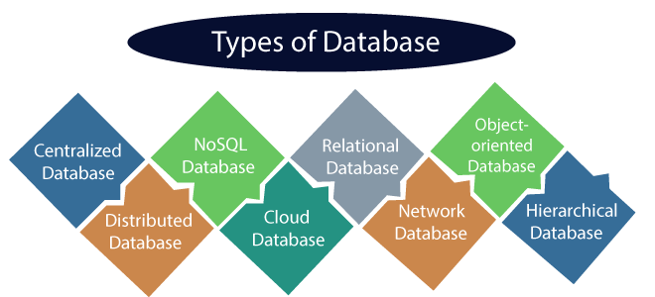
Used for storing a wide range of data sets. Eg:Document-based (MongoDB)
Based on the relational data model, which stores data in the form of rows(tuple) and columns(attributes), and together forms a table(relation). Eg: MySQL
Stores data at a centralized database system. Eg: Central Library
Store data in the form of objects, which can include data and behavior. Eg: db4o
Stores data in the form of parent-children relationship nodes.
Data is distributed among different database systems of an organization. Eg: Apache Cassandra
Data is stored in a virtual environment and executes over the cloud computing platform. Eg: AWS
Database that typically follows the network data model. Here, the representation of data is in the form of nodes connected via links between them.

Slide 4
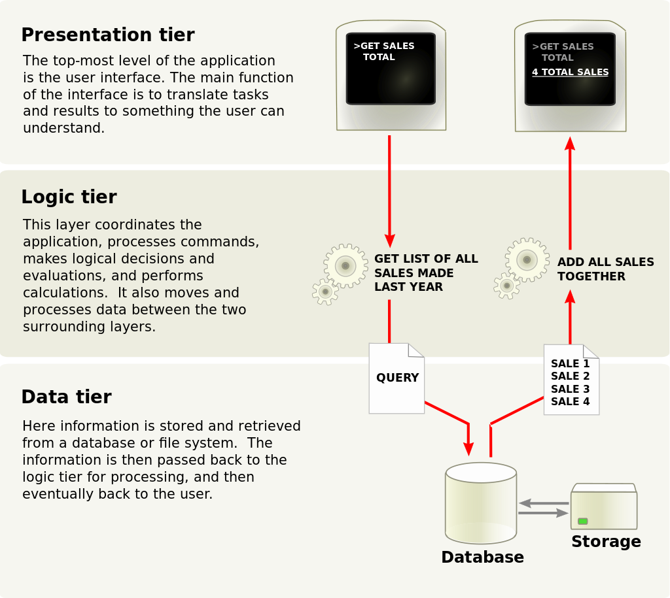
Database Three-tier Architecture

Slide 5
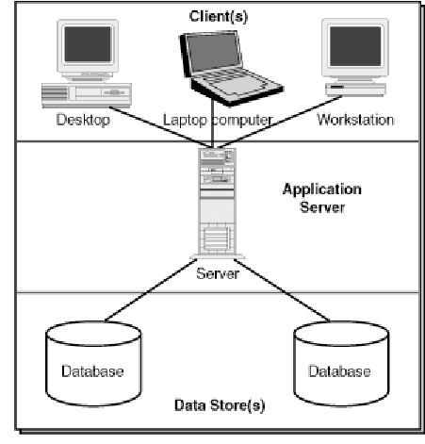
Database client server architecture
Clients request services from a centralized server, which manages data and processes requests.

Slide 6
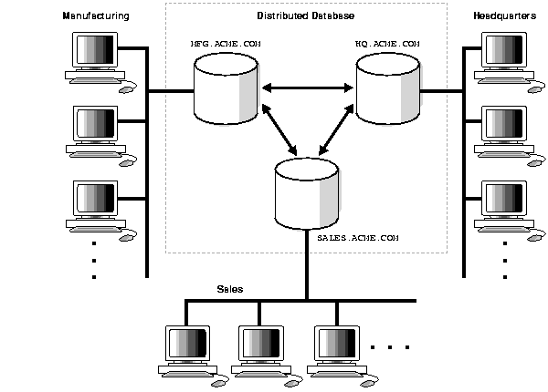
Distributed Databases architecture
Data is spread across multiple locations or nodes, allowing for scalability and fault tolerance.

Slide 7
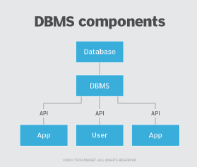
What is a DBMS?
A database management system (DBMS) is middleware that allows programmers, database administrators (DBAs), software applications and end users to store, organize, access, query and manipulate data in a database.
In the enterprise, database management systems provide database administrators (DBAs) with a structured framework that facilitates data sharing among different departments, teams and applications.
The DBMS provides employees with controlled and organized access to data that they can use to drive innovation and help their company maintain a competitive edge.

Slide 8
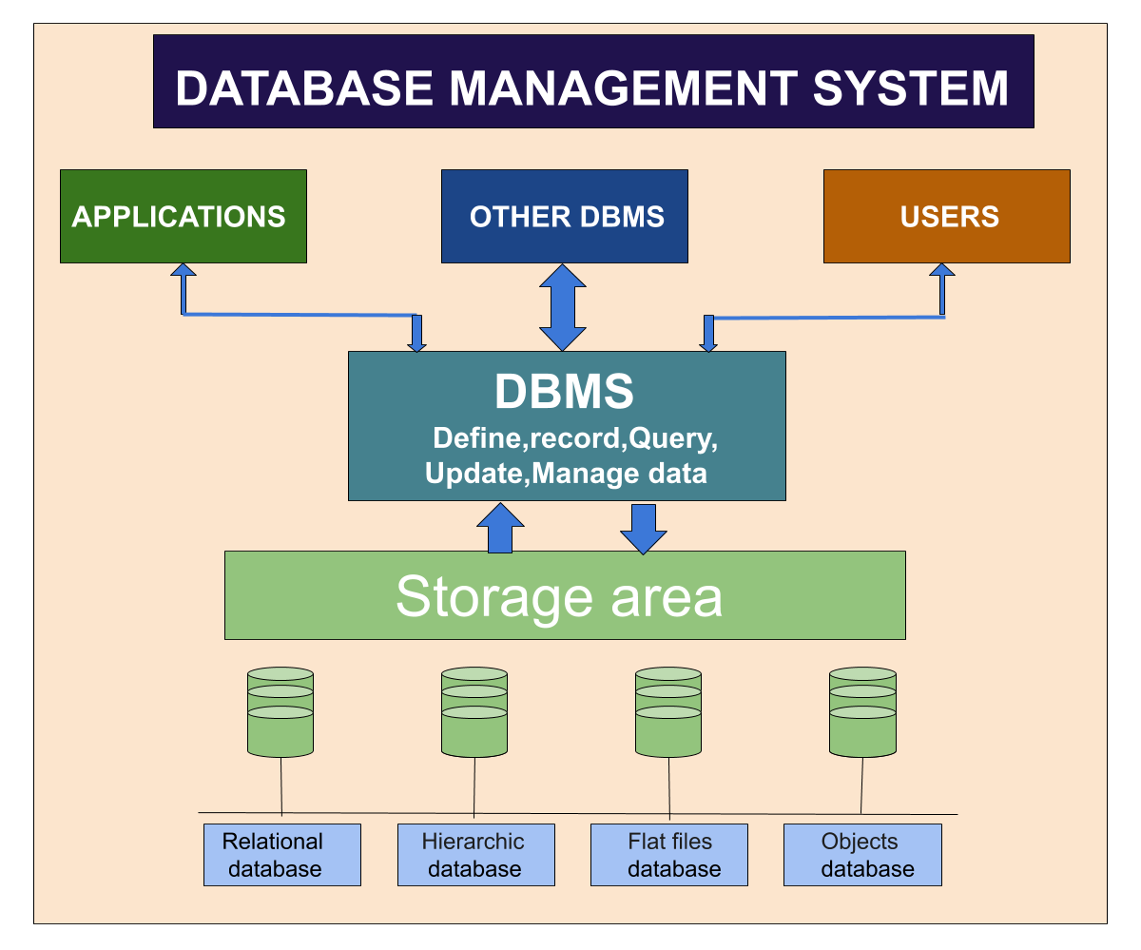

Slide 9
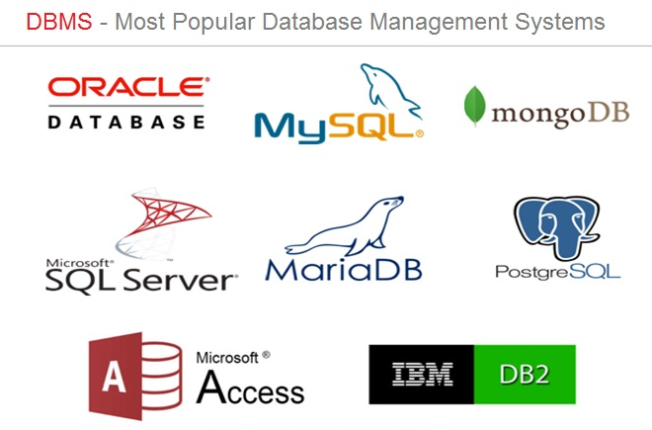

Slide 10
What is RDBMS?
RDBMS stands for Relational Database Management System. RDBMS is the basis for SQL, and for all modern database systems like MS SQL Server, IBM DB2, Oracle, MySQL, and Microsoft Access.
A Relational database management system (RDBMS) is a database management system (DBMS) that is based on the relational model as introduced by E. F. Codd in 1970.

Slide 11
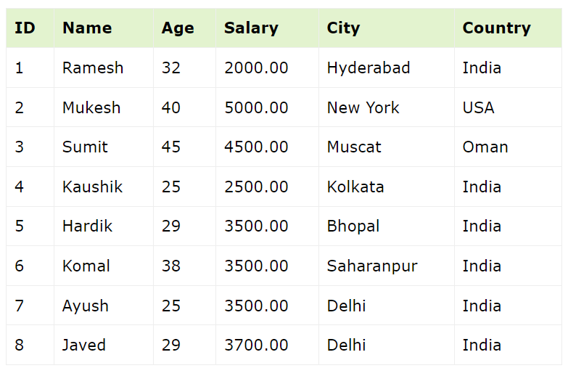
Fields
Table
Record
Degree:
The total number of attributes that comprise a relation is known as the degree of the table. Eg: Here the degree is 6
Cardinality:
The total number of tuples at any one time in a relation is known as the table's cardinality. The relation whose cardinality is 0 is called an empty table. Here the cardinality is 8.

Slide 12
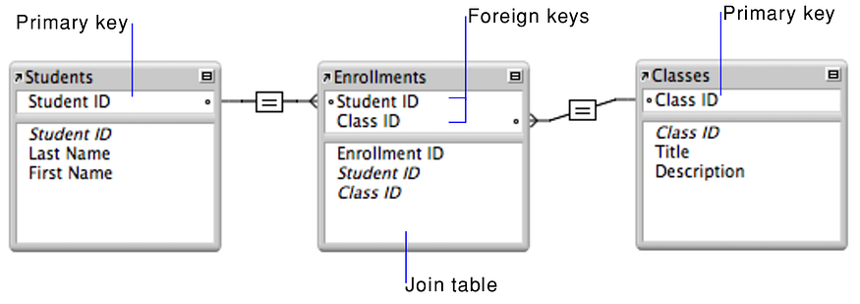
Primary key Vs Foreign Key
The foreign key is a key used for a different table of data which is referred by the primary key. There are many foreign keys for a single table. It depends on the primary key and its decision to refer those foreign keys to the table. Every foreign key can be shared and it speaks about the coordination among the data of different tables.
The primary key finds out the similarity in the relationship. For the entire table, there is only one primary key. Every table has got a particular primary key that cannot be shared by other tables.

Slide 13
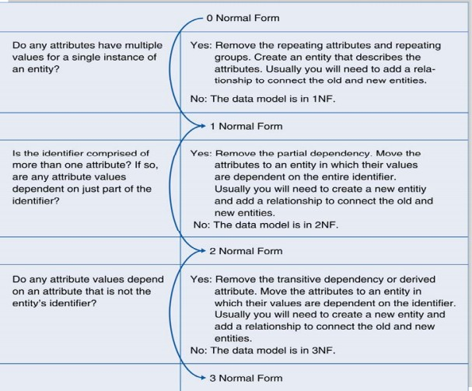
Normalization
Normalization is the process of organizing data into a related table; it also eliminates redundancy and increases the integrity which improves performance of the query. To normalize a database, we divide the database into tables and establish relationships between the tables.

Slide 14
First Normal Form (1NF)
A relation is in 1NF if it only contains atomic (indivisible) values, and there are no repeating groups or arrays.
Each column in a 1NF table must have a unique name.
StudentID | Course
1 | Math
1 | Science
1 | History
2 | English
2 | Math
StudentID | Courses
1 | Math, Science, History
2 | English, Math

Slide 15
Second Normal Form (2NF)
A relation is in 2NF if it is in 1NF and all non-key attributes are fully functionally dependent on the entire primary key.
Authors Table
ISBN | AuthorID | AuthorName | Title
123456789 | 1 | John Doe | Book A
123456789 | 2 | Jane Doe | Book A
987654321 | 3 | Jim Smith | Book B
AuthorID | AuthorName
1 | John Doe
2 | Jane Doe
3 | Jim Smith
Books Table:
In this table, the combination of ISBN and AuthorID is the primary key. However, AuthorName is functionally dependent only on AuthorID, not on the entire primary key. To bring it into 2NF, you would separate the information into two tables: Authors Table and Books Table
ISBN | AuthorID | Title
123456789 | 1 | Book A
123456789 | 2 | Book A
987654321 | 3 | Book B

Slide 16
Third Normal Form (3NF)
A relation is in 3NF if it is in 2NF and all the attributes are functionally dependent only on the primary key.
Employees Table
EmployeeID | EmployeeName | Department | ManagerID
1 | John Doe | HR | 3
2 | Jane Doe | Marketing | 1
3 | Jim Smith | HR | NULL
EmployeeID | EmployeeName | ManagerID
1 | John Doe | 3
2 | Jane Doe | 1
3 | Jim Smith | NULL
In this table, the "Department" attribute is transitively dependent on the primary key (EmployeeID). To bring it into 3NF, you would split the table into two:
Employees Table and Departments Table
Departments Table
DepartmentID | Department
1 | HR
2 | Marketing

